Slide 1
How do cowboys dress?
Today’s class: Review target vocabulary (clothing) by doing a matching game.
-Teacher will ask students: ’’ Where is …………’’
Student must clic on the correct box on the picture
Audrey Gagné
Camille Vanasse

Slide 2
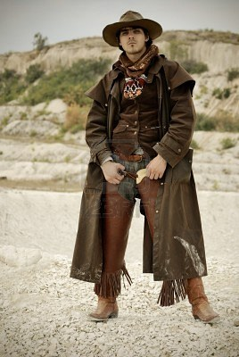
WHERE is/are………..

Slide 3
The Hat?

Slide 4
SORRY! TRY AGAIN

Slide 5
VERY GOOD!!

Slide 6
The boots?

Slide 7
SORRY! TRY AGAIN

Slide 8
VERY GOOD!!

Slide 9
The scarf?

Slide 10
SORRY! TRY AGAIN

Slide 11
VERY GOOD!!

Slide 12
The belt?

Slide 13
SORRY! TRY AGAIN

Slide 14
VERY GOOD!!

Slide 15
The shirt?

Slide 16
SORRY! TRY AGAIN

Slide 17
VERY GOOD!!

Slide 18
The chaps?

Slide 19
SORRY! TRY AGAIN

Slide 20
VERY GOOD!!

Slide 21
The coat?

Slide 22
SORRY! TRY AGAIN

Slide 23
VERY GOOD!!

Slide 24
Congratulations!!

